Slide 1

DJJJ Presents
LBTS
Library Borrowing and Tracking System
Dawson, Brown
Judah, Csanyi
Joshua, Leslie
Jeremy, Paruch

Slide 2
Why this project?

Slide 3
Disclaimer*
Some slides contain outdated code, the project has since been updated. Our github repository contains the up to date code.
It works, we promise! :D

Slide 4
Meet
The
Team

Slide 5

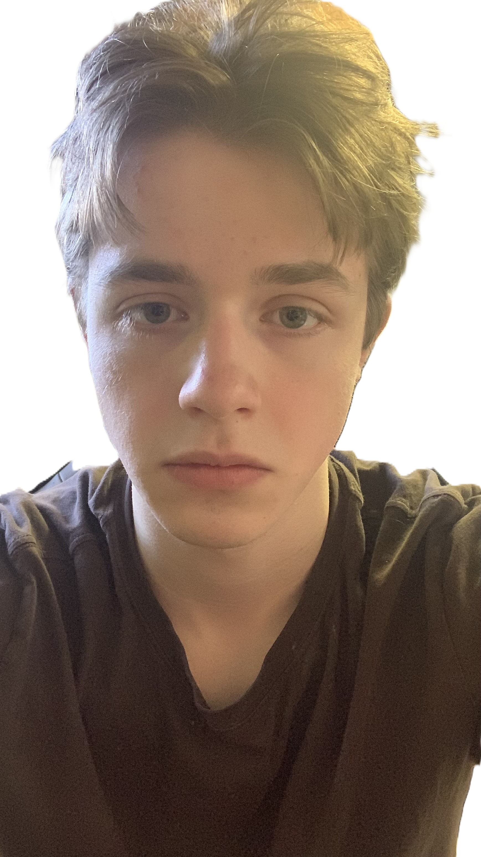


Meet
The
Team
Primary: Testing & Document- Main Speaker
Primary: Back End Developer
Primary: Back End Developer
Primary: UI and Integration Specialist
Dawson Brown
Judah Csanyi
Joshua Leslie
Jeremy Paruch
Secondary: Speaker
Secondary: Bug Catcher
Secondary: Back-end Developer
Secondary: Back-end Developer

Slide 6









Main Menu

Slide 7






LogIn
User Login

Slide 8
1

Slide 9
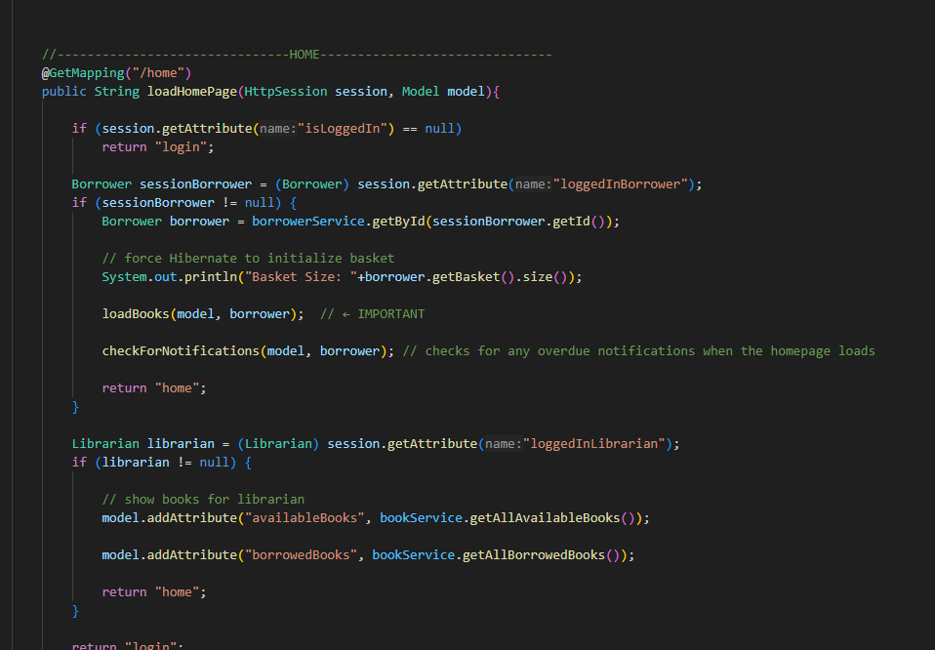
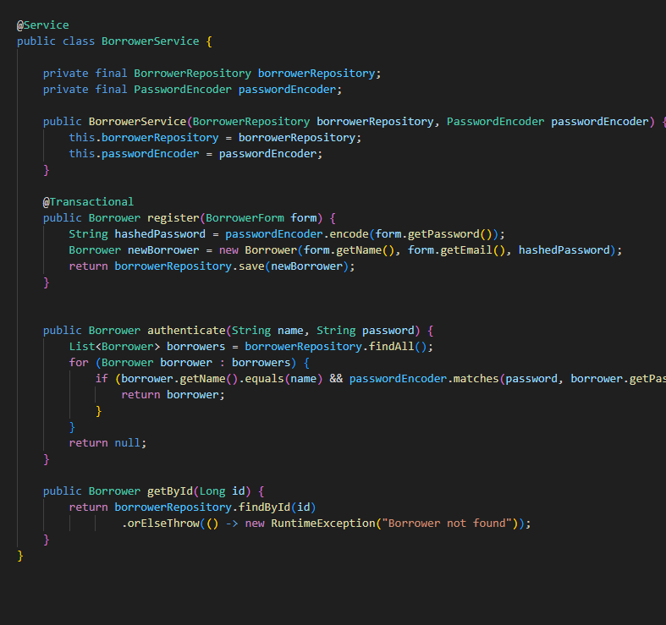
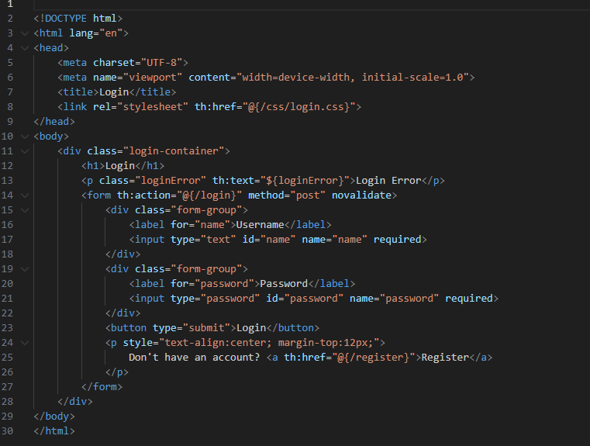
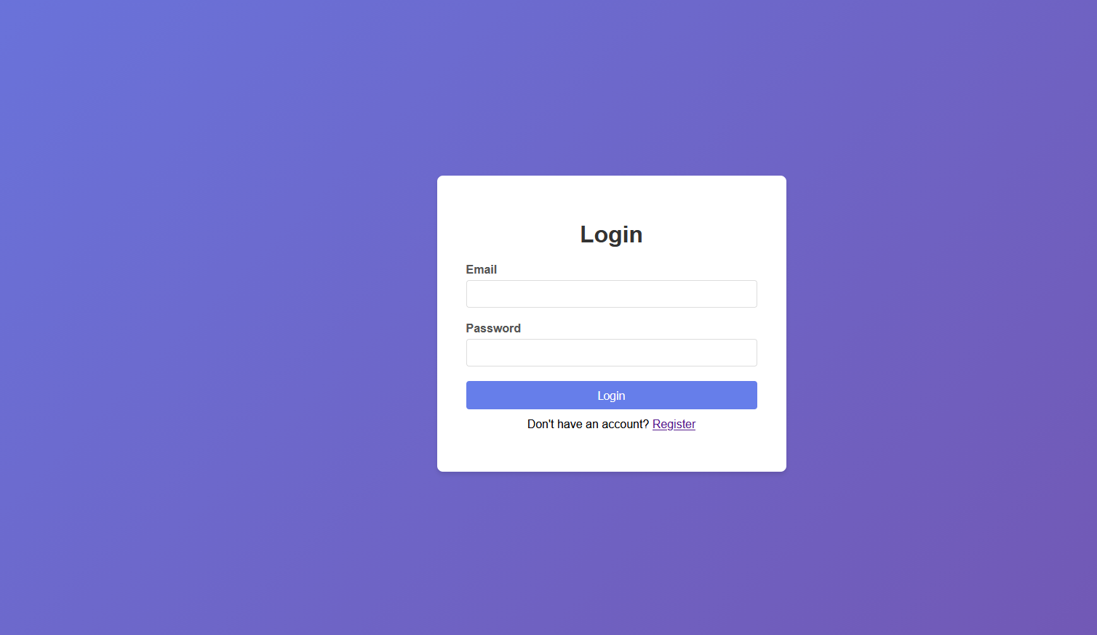
Login Page
1

Slide 10
2

Slide 11
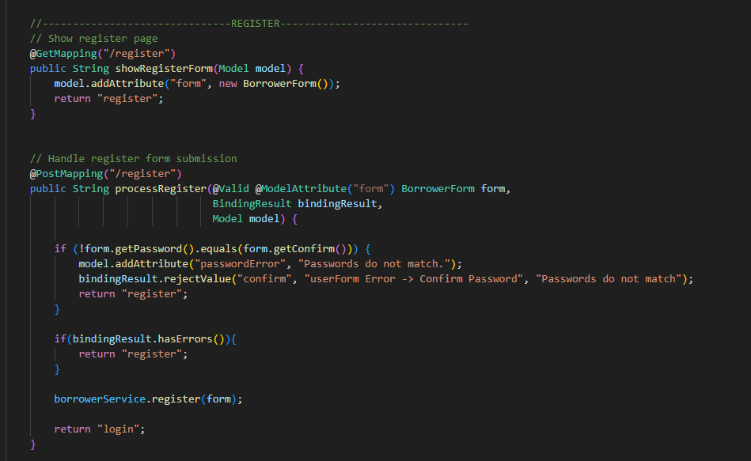
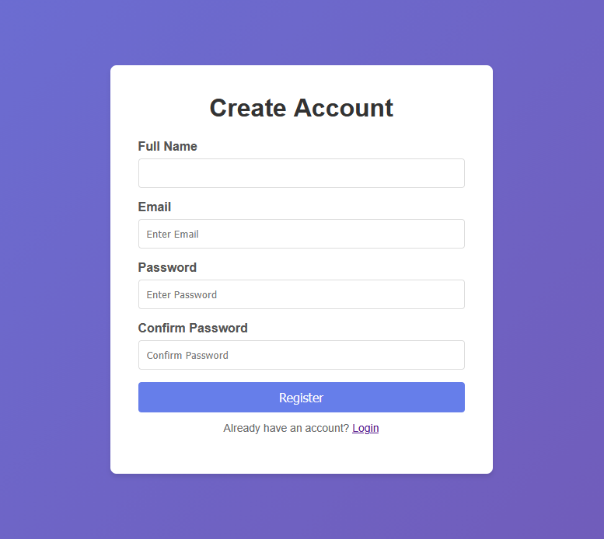
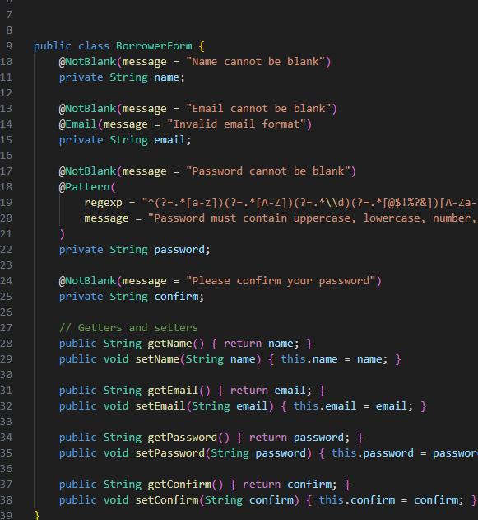
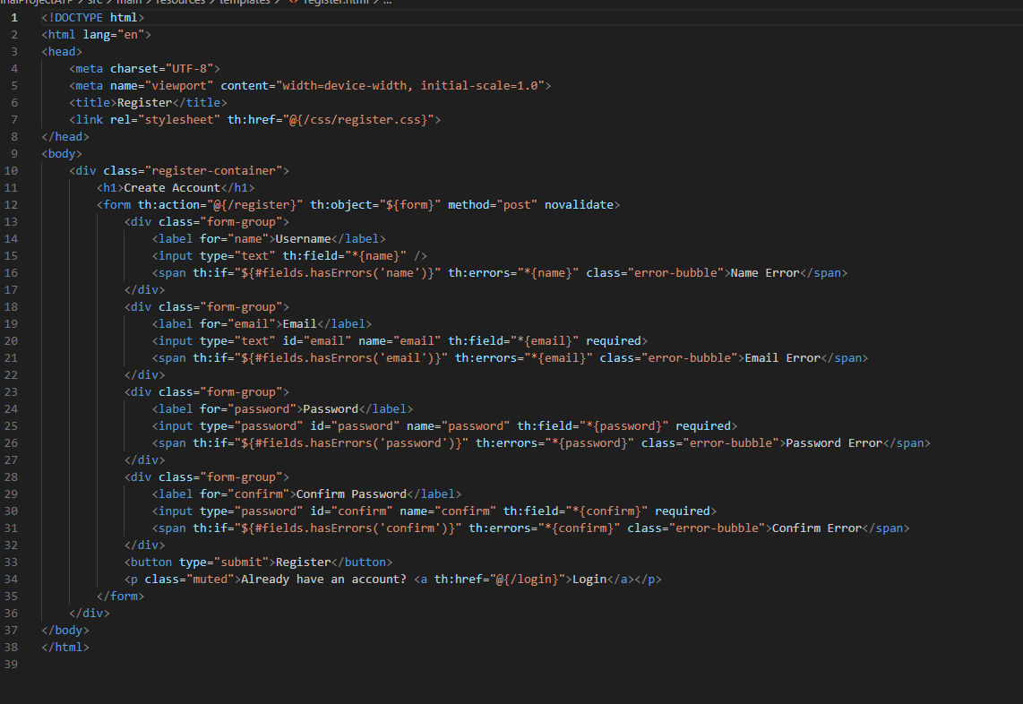
Register User
2

Slide 12
3

Slide 13
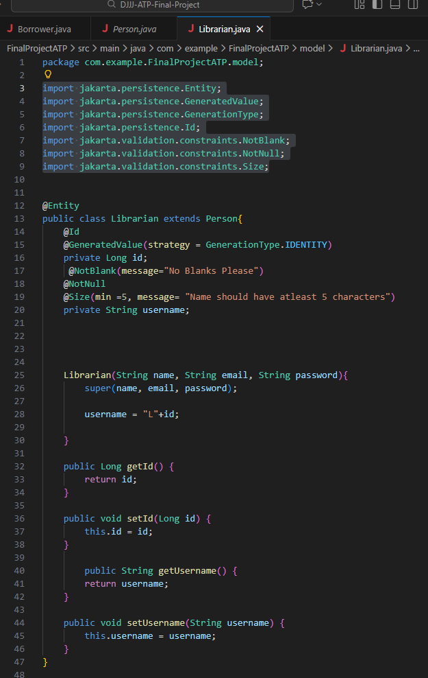
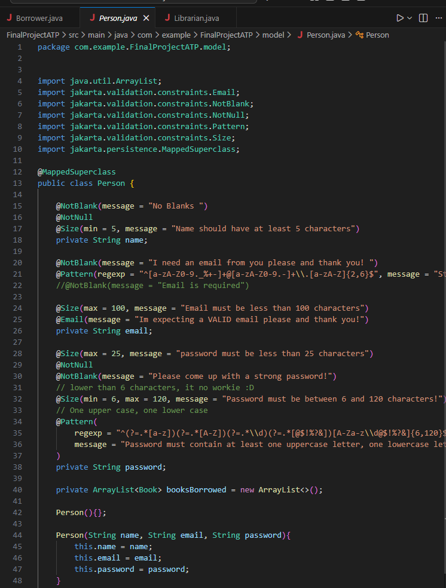
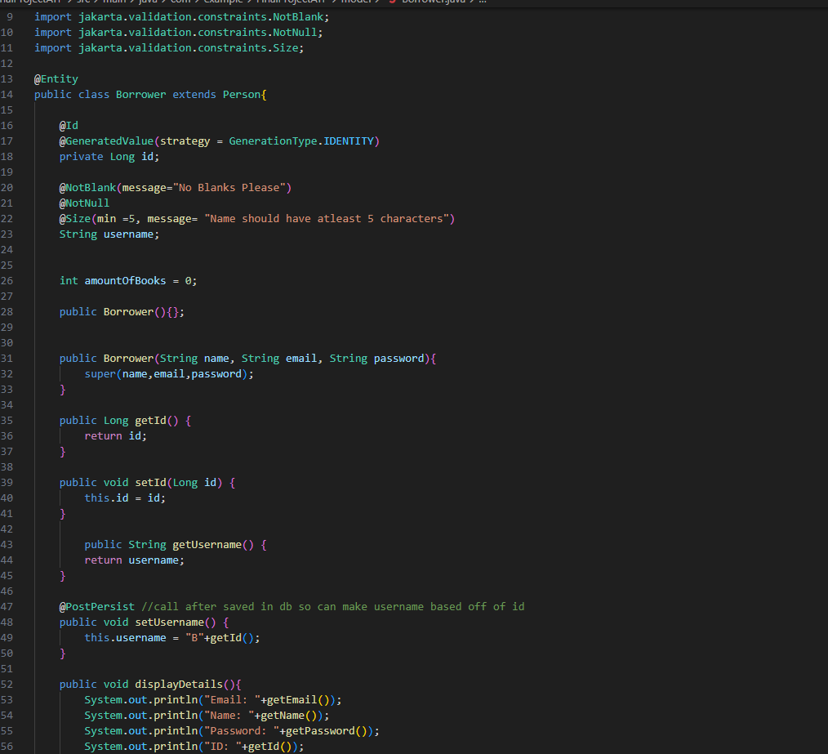
Borrower and Librarian Settings
3

Slide 14
4

Slide 15
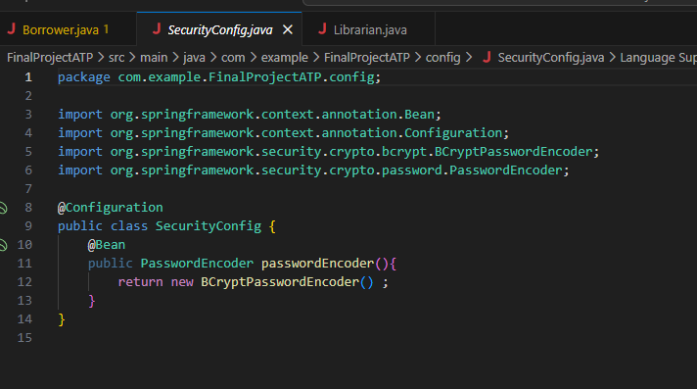
Config Security
4

Slide 16




Books
Books

Slide 17
1

Slide 18
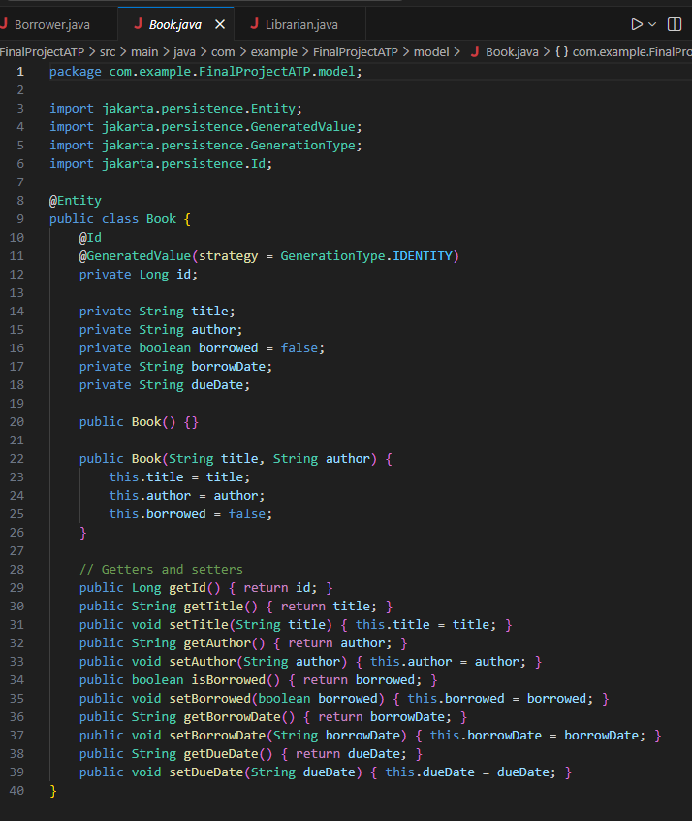
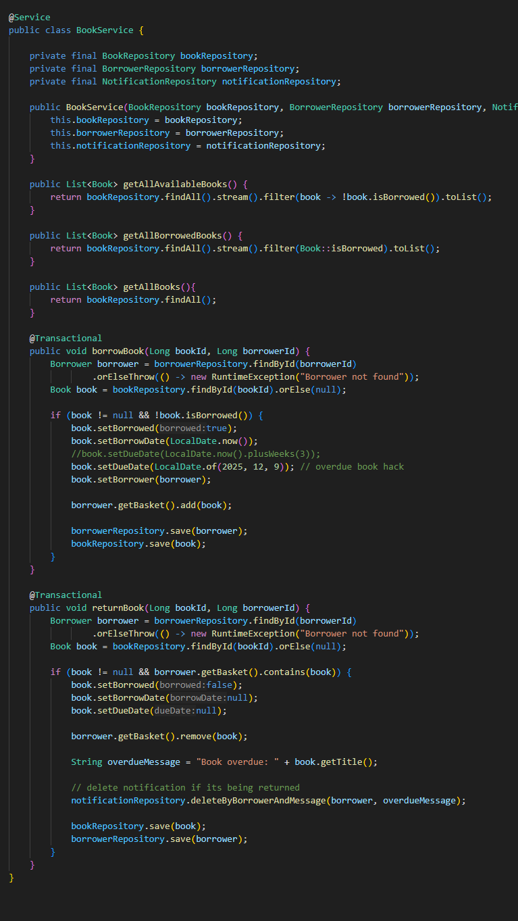
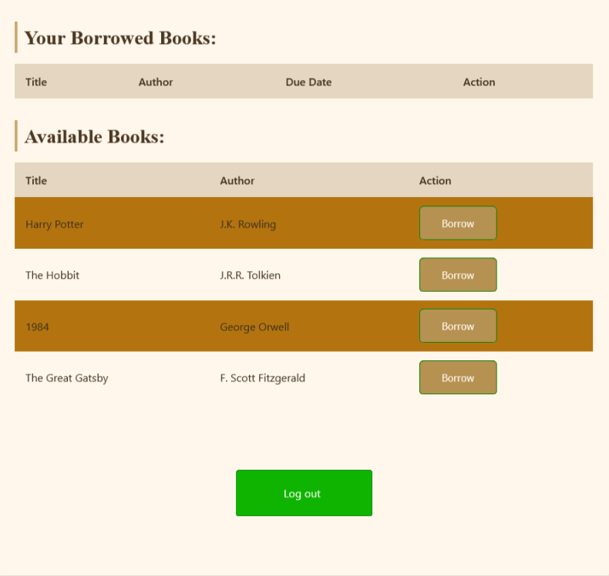
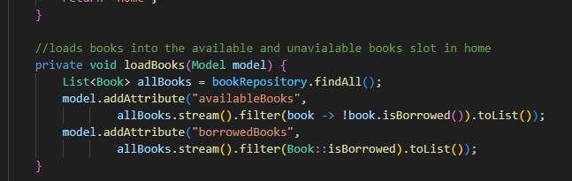
The Books
1

Slide 19
2

Slide 20
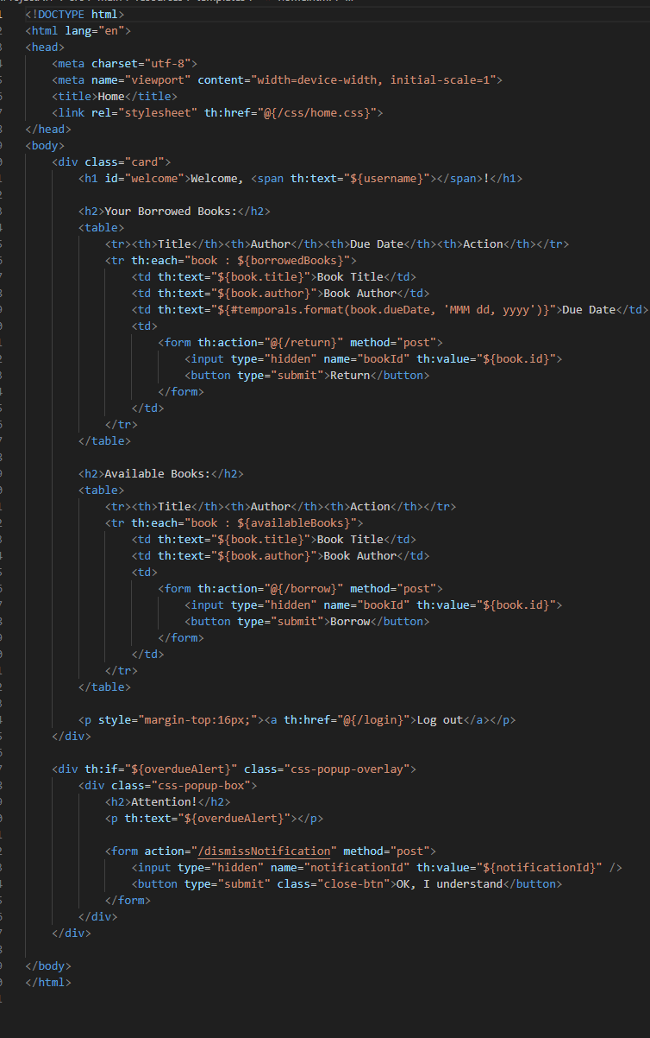
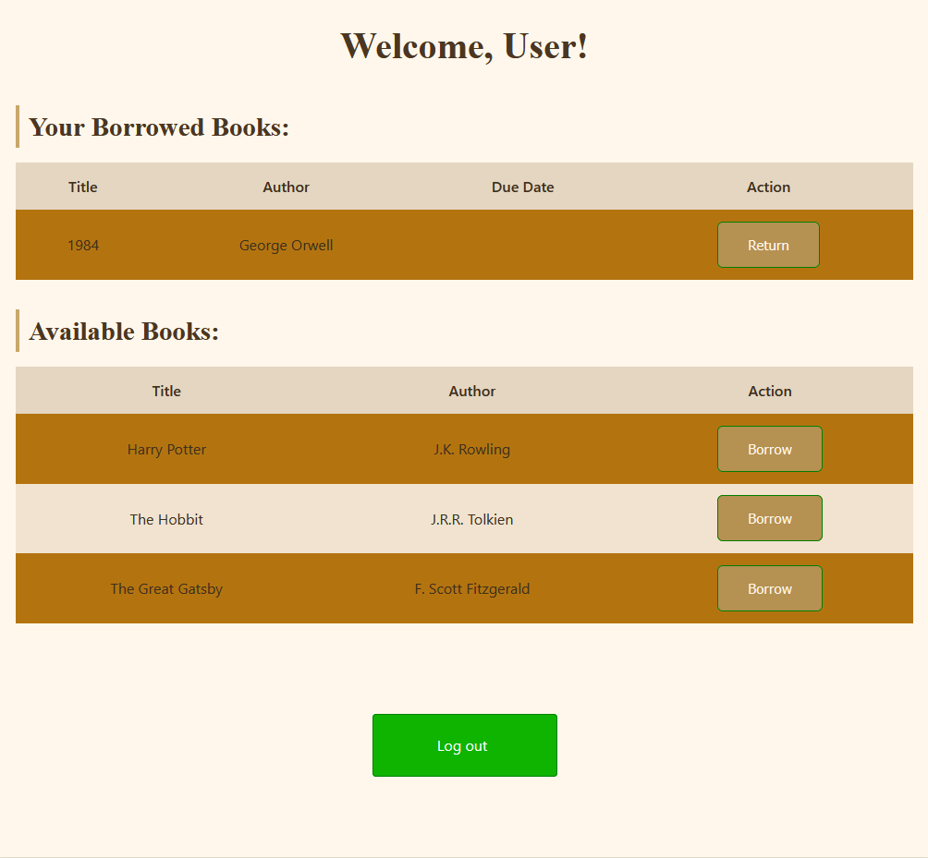
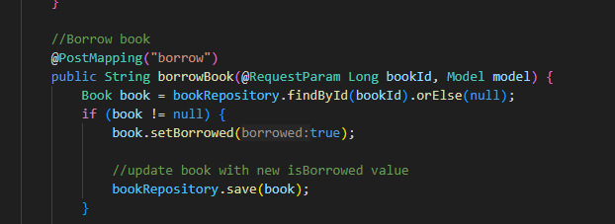
Return the Books
2

Slide 21
3

Slide 22
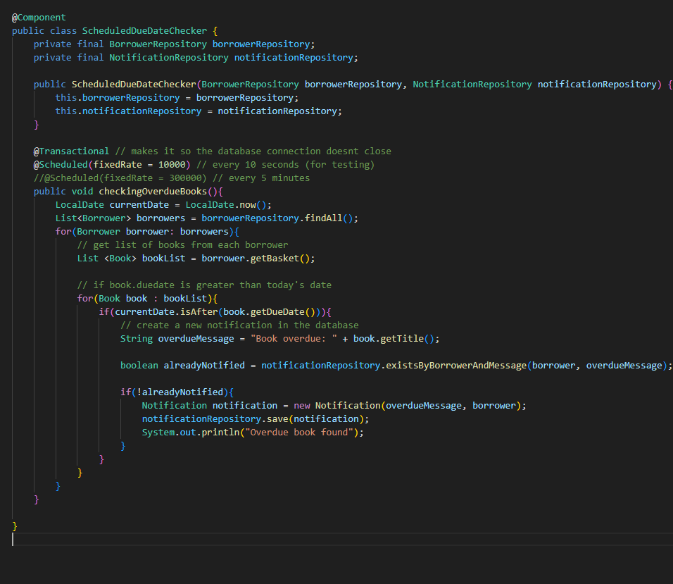
Notifcations
3

Slide 23




Diagrams
Diagrams

Slide 24
1

Slide 25
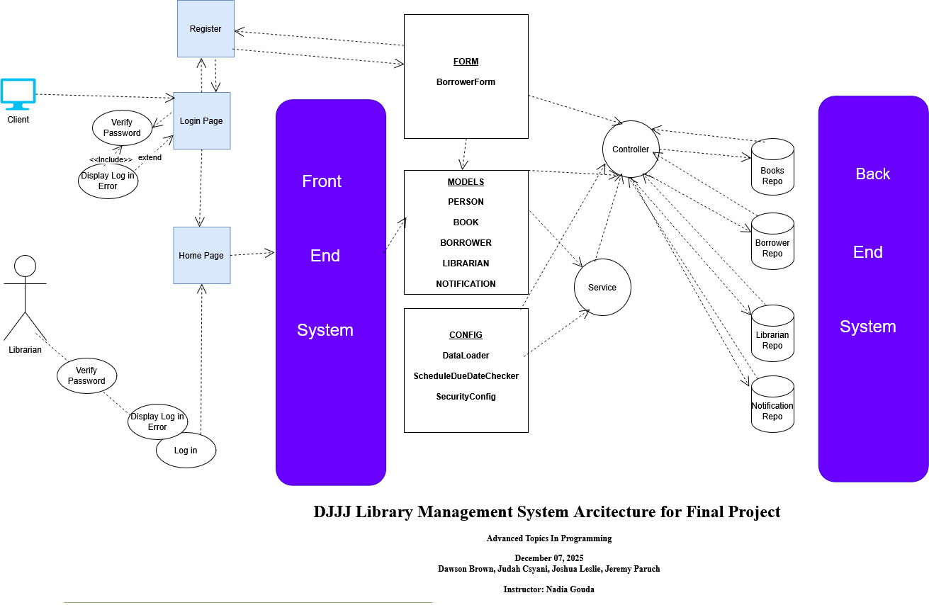
System Architec
1

Slide 26
2

Slide 27
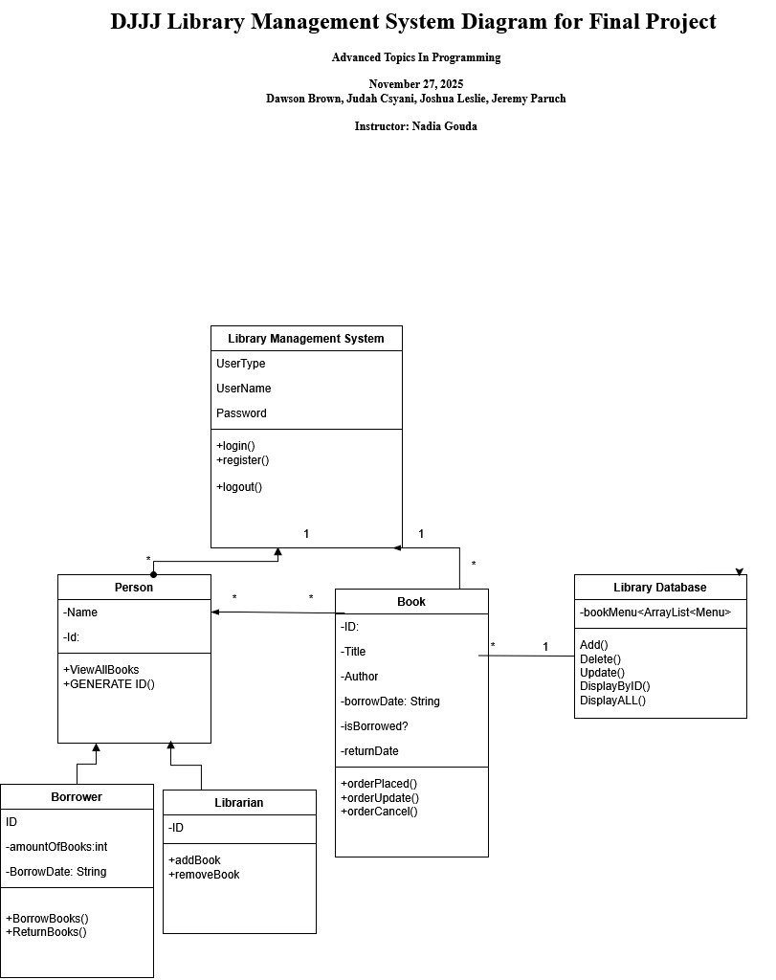
UML Diagram
2

Slide 28
3

Slide 29
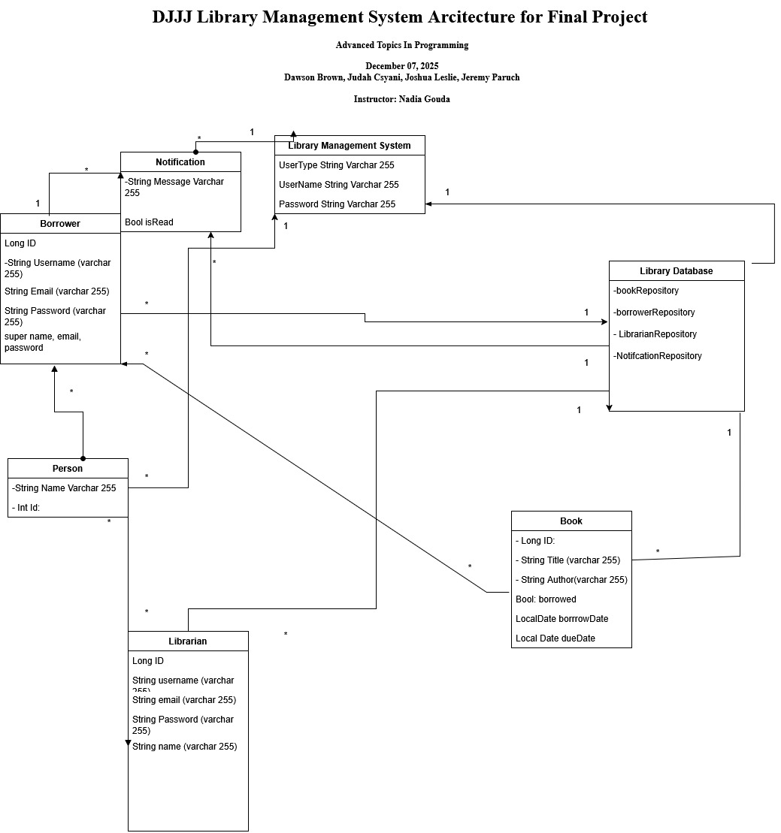
Database
3

Slide 30

LIVE DEMO
Live Demo!

Slide 31

Why Us?
Why us?

Slide 32
1

Slide 33
Efficiency
1
We know everything already
Nothing is secret
Nothing is Safe
Delicious Credit Credentials >:)
We are efficient
Everything Is secure
Peace of mind

Slide 34

Closing Remarks
Thank you!

Slide 35

Questions

Slide 36
Reference
Paruch, J.(2025, April 11). 20250411-Brown_Dawson Csanyi_Judah ,Leslie_ Joshua , Paruch_ Jeremy OOP-ASSIGNMENT-POWERPOINT.pptx
NSCC BrightSpace Prog1400 Final Project Submission Box

